Slide 1
THE POTENTIALS OF WINE REGIONS FOR THE FORMATION OF CULTURAL LANDSCAPES: EUROPEAN EXPERIENCES
ANA STANOJEVIĆ
BRANKO AJ TURNŠEK
LJILJANA JEVREMOVIĆ
MARINA JORDANOVIĆ
ISIDORA ĐORĐEVIĆ
FACULTY OF CIVIL ENGINEERING AND ARCHITECTURE, NIS

Slide 2
ANA STANOJEVIĆ
Junior Research Assistant, PhD student, Faculty of Civil Engineering and Architecture, University of Nis, Serbia, ana.stanojevic@gaf.ni.ac.rs
BRANKO AJ TURNŠEK
PhD, Associate Professor, Faculty of Civil Engineering and Architecture, University of Nis, Serbia, ajbranko@yahoo.com
LJILJANA JEVREMOVIĆ
PhD candidate, Teaching Assistant, Faculty of Civil Engineering and Architecture, University of Nis, Serbia, jevremovicljiljana@gmail.com
MARINA JORDANOVIĆ
PhD Student, Faculty of Civil Engineering and Architecture, University of Nis, Serbia, marinajordanovic@gmail.com
ISIDORA ĐORĐEVIĆ
PhD Student, Scholarship holder of Ministry of Education, Science and Technological Development, Faculty of Civil Engineering and Architecture, University of Nis, Serbia, isidoradjordjevic7@gmail.com

Slide 3
Introduction - Landscapes
Contemporary strategies of spatial and urban planning inevitably integrate numerous landscapes of exceptional values;
Landscapes have evolved over the centuries, resist, or are slightly transformed under the influence of numerous economic, cultural, and environmental factors that accompany social development;
According to the 2000 European Convention, a landscape is "an area, as seen by the population, and whose character is the result of actions and interactions of natural and/or cultural factors„
European Convention is the first document to further define the promotion, management, and planning of landscapes considered as a common European heritage;
It promotes a holistic approach to landscapes, not separating protected natural and cultural assets from those degraded;

Slide 4
Introduction – Cultural landscapes
The landscape that has been changed by human activities is cultural landscape;
According to Carl Sauer, a prominent American geographer, a cultural landscape is „created under the influence of culture or cultural group, where culture is an agent, natural environment a mediator, and landscape the final result“
In 1992, cultural landscape has been recognized by the World Heritage Committee as a category of the site in the World Heritage List;
The value of the cultural landscape is based on authenticity and autochthony, biological and geological diversity, preservation, the richness of natural phenomena and processes, and sustainable development in a global context;

Slide 5
Introduction – Wine cultural landscapes
21st century brings the expansion of winemaking, wine architecture and wine tourism;
Our research examines wine regions and their potential for cultural landscapes;
The paper aims to examine the characteristics and values ​​of wine regions that qualify them for cultural landscapes of exceptional importance;
The research is based partly on a comparative analysis of officially recognized wine cultural landscapes: terroirs of Burgundy in France, Tokaj region in Hungary, Vineyard Landscape of Piedmont in Italy, and Aldo Douro Wine Region in Portugal.
Referring to the methodological criteria framework of UNESCO for qualifying an area as a cultural landscape, the paper aims to point out which potentials of wine regions are crucial for the formation of cultural landscapes

Slide 6
UNESCO’s Cultural Landscape Approach
According to UNESCO, 114 properties with 5 transboundary properties (1 delisted property) on the World Heritage List have been included as cultural landscapes;
There are three different types of cultural landscapes:
landscapes designed and created intentionally by man (gardens, rural landscapes, parklands close to castles, monasteries etc.),
organically evolved landscapes which reflect the process of evolution in their form and features (relict landscapes-when an evolutionary process finished in the past; the vernacular landscape-when landscape is associated with the traditional way of life while the evolutionary process is still in progress),
associative cultural landscape (indicates the powerful influence of religion, culture, or nature- industrial complexes, areas related to war events, beliefs, and cults)

Slide 7
UNESCO’s Cultural Landscape Criteria
 | Criterion description
i | represent a masterpiece of human creative genius
ii | exhibit an important interchange of human values, over some time or within a cultural area of the world, on developments in architecture or technology, monumental arts, town-planning or landscape design
iii | bear a unique or at least exceptional testimony to a cultural tradition or to a civilization which is living or which has disappeared
iv | be an outstanding example of a type of building, architectural or technological ensemble or landscape which illustrates (a) significant stage(s) in human history
v | be an outstanding example of a traditional human settlement, land-use, or sea-use which is representative of a culture (or cultures), or human interaction with the environment especially when it has become vulnerable under the impact of irreversible change
vi | be directly or tangibly associated with events or living traditions, with ideas, or with beliefs, with artistic and literary works of outstanding universal significance
vii | contain superlative natural phenomena or areas of exceptional natural beauty and aesthetic importance
viii | be outstanding examples representing major stages of earth's history, including the record of life, on-going geological processes in the development of landforms, or geomorphic or physiographic features
ix | be outstanding examples representing significant on-going ecological and biological processes in the evolution and development of terrestrial, freshwater, coastal, and marine ecosystems and communities of plants and animals
x | contain the most important and significant natural habitats for in-situ conservation of biological diversity, including threatened species of Outstanding Universal Value from science or conservation

Slide 8
Wine cultural landscapes
Wine cultural landscapes represent landscapes formed by humans while creating a natural environment through the use of land for growing vines and an artificial environment by building facilities for wine production;
Integral element of wine cultural landscapes:
natural factors-terroir vineyards
cultural-artificial factors-wine production process, architecture of wine cellars and wineries;
Terroir methodology, derived from the French words territorie and terre, is a concept that combines environmental factors such as climate, soil composition, terrain topography, context, and nearby materials, which are closely related to vineyards and winery facilities.

Slide 9
Comparative analysis
The comparative analysis includes 4 wine regions that have been recognized by UNESCO: Tokaj in Hungary, Climats-terroirs of Burgundy in France, Alto Douro in Portugal, and Vineyard Landscape of Piedmont: Langhe-Roero and Monferrato in Italy;
The areas were analyzed from the aspect of historical development, geographical distribution, and development of winemaking and wine architecture in that area;
Study area | State | Area [ha] | Year of inscription | UNESCO’s criteria
 |  |  |  | i | ii | iii | iv | v | vi | vii | viii | ix | x
Tokaj wine region | Hungary | 13.255 | 2002
Alto Douro region | Portugal | 24.600 | 2001
Climats, Burgundy | France | 13,219 | 2015
Land. Piedmont | Italy | 10.789 | 2014

Slide 10
1. Tokaj Wine Region, Hungary - History
The Tokaj wine region occupies the northeastern part of Hungary and includes seven wine subregions that are spread between 28 settlements, of which Tokaj is the largest;
The first clear traces of viticulture and winemaking in this area appear at the beginning of the 12th century;
In the 17th century, the wine was the main source of income and one of the resources for repaying independence from the Habsburg monarchy;
The area is considered to be the first wine region to be recognized in the 18th century through the wine classification system of Europe;
The area has been on the UNESCO list since 2002;

Slide 11
1. Tokaj Wine Region, Hungary - Character
The region is characterized by a specific microclimate, which is especially suitable for the production of so-called aszu, sweet wine for which Hungary has long been known;
The area is protected by the Carpathian mountain range, while the composition of the land is diverse - volcanic clay, the lower-lying layers of land wood, sandy base;
The production of grape varieties Furmint, Harslever, Yellow Muscat, Kövérszőlő, Zéta, and Kabar;
Hundreds of cellars are buried several meters in cold volcanic rocks that provide an optimal temperature for wine aging;
One of the most famous cellars is those in the Swabian village of Hercegkut, which are a masterpiece of architecture.

Slide 12
1. Tokaj Wine Region, Hungary - Character
Many additional facilities make the region interesting for visitors, such as medieval castles, monasteries, natural walking routes, local vernacular wineries (190), etc.
The region is included on the UNESCO list according to criteria (iii) and (v) - the region represents a distinct viticultural tradition that has existed for at least 1000 years while the entire landscape, including both vineyards and long-established settlements, vividly illustrates the specialized form of traditional land use that it represents.

Slide 13
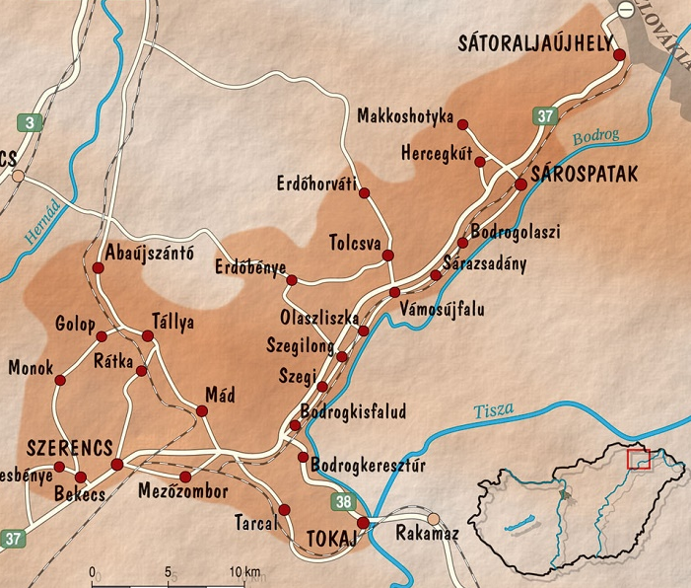
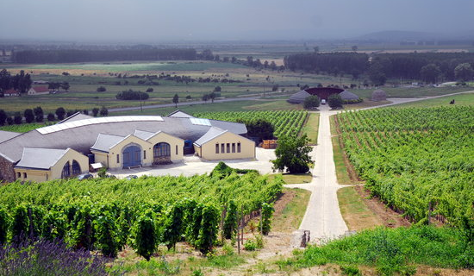
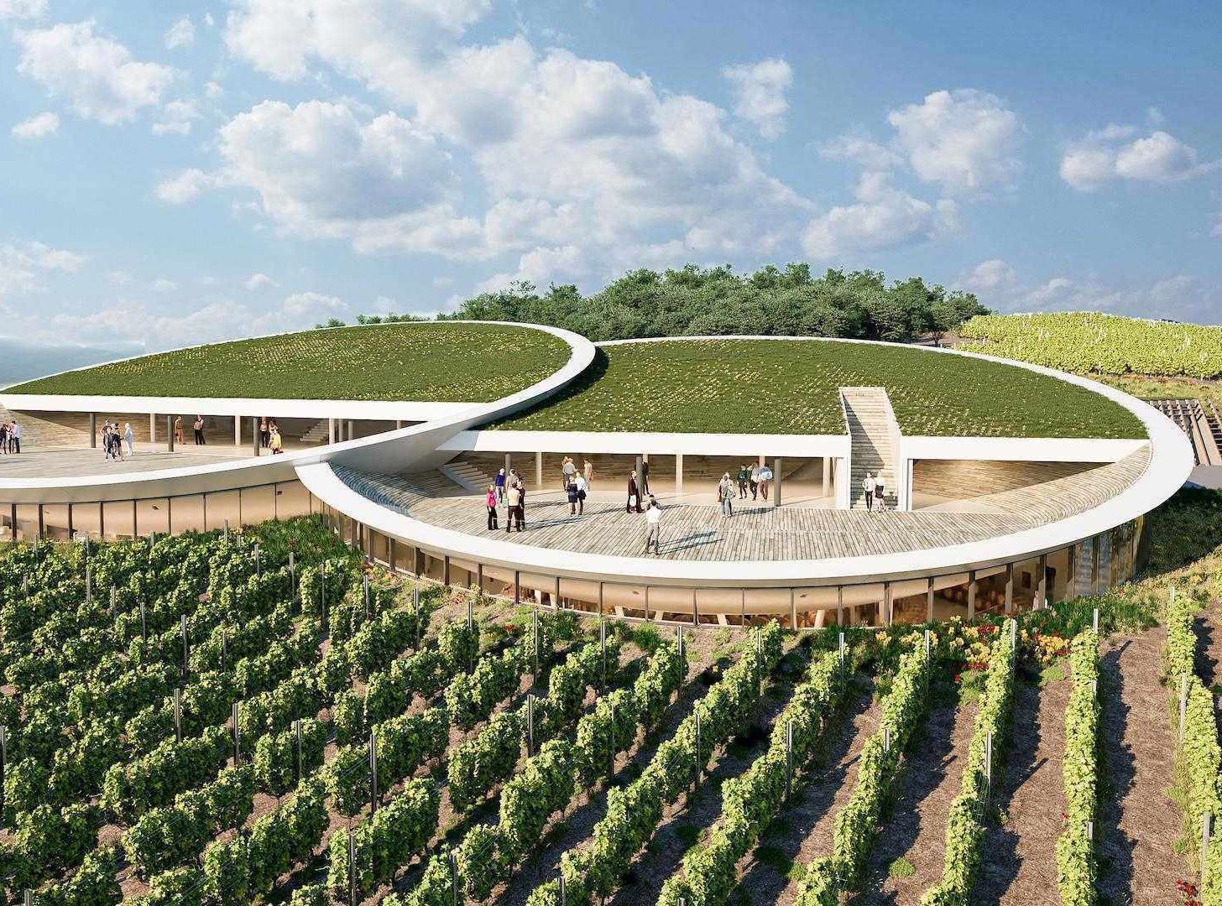
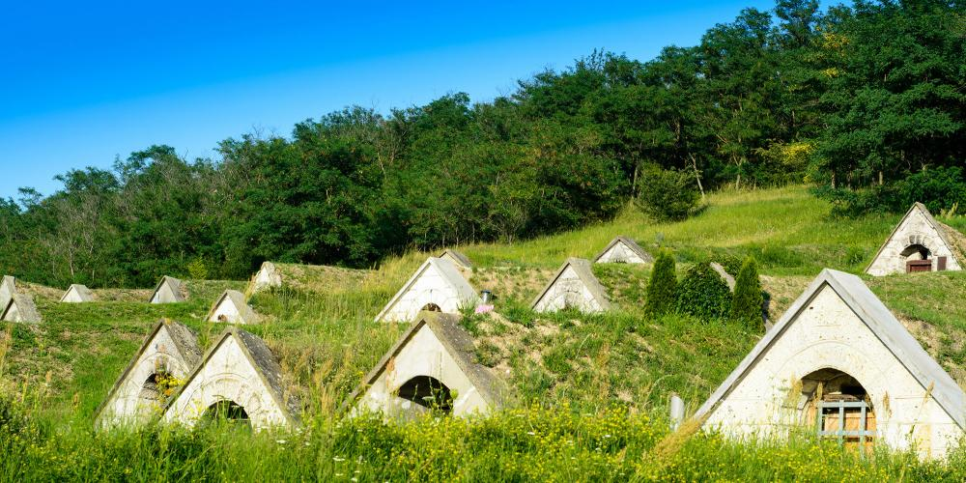

Slide 14
2. Alto Douro, Portugal - History
Alto Douro is a wine region that stretches along the valley of the river Douro and in the lower valleys of its tributaries;
Research shows that wine was produced in this area during the Roman Empire;
In the medieval period it was kept within the monastery complex;
In the 18th century, the region was officially adopted as the wine region to enter the wine classification system in Europe;
Port wine is registered as an autochthonous wine of this area;
The landscape has been on the World Heritage List since 2001.

Slide 15
2. Alto Douro, Portugal - Character
The area is protected from the winds from the Atlantic Ocean, by the mountain ranges of Marao and Montemuro, the land is rocky;
The region is located in the continental climate zone - warm and extremely dry summers and cold winters;
Of the over 100 types of vines grown: Bastardo, Tinta Amarela, Tinta Roriz, Gouveio, Rabigato, etc.
Terraced vineyards illustrate the long tradition of winemaking;
In the 19th century - narrow and irregular terraces were built, which included only two rows of vines;
In the 20th century - wider continuous, and properly shaped terraces that are slightly sloping and enable optimal sunbathing of the vineyards.

Slide 16
2. Alto Douro, Portugal - Character
Vineyards occupy each hilly landscape along with numerous estates (Quintas) and agricultural facilities;
The landscape is also recognizable by its white walls and houses, a large number of chapels, and natural national parks;
The urban layout of the buildings, grouped farm buildings, and the wineries that surround the main building - authenticity;
The landscape was nominated for the UNESCO list meeting criteria (iii), (iv) and (v);
The natural elements are recognized through the physical environment defined by the complex system of river valleys and vineyards, while the cultural dimension of the landscape consists of vineyards, and other buildings as well as walls.

Slide 17
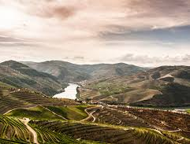
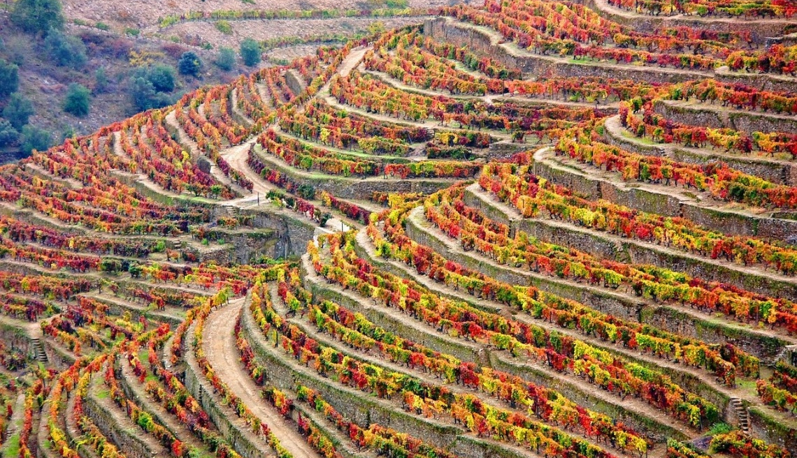
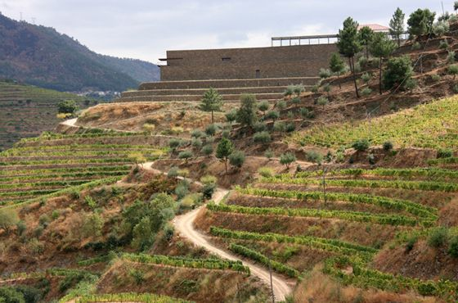
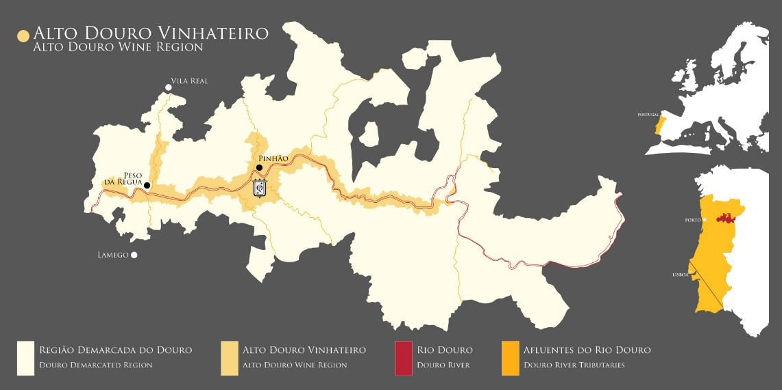

Slide 18
3. Climats Burgundy, France - Character
The area is occupied by properly formed vineyard plots positioned on the slopes of the Cote de Nuits and Cote de Beaune mountains, south of the French city of Dijon;
The region consists of two units - vineyards grouped around the town of Beaune and the historic center of Dijon;
Vines have been grown in this area since Roman times, while Burgundy later became one of the most famous wine regions;
The microclimate is unique, characterized by a mixed influence of continental, Mediterranean, and oceanic climates, hence the symbolic name Climats;
The area is located at an altitude of 200-500m above sea level on a slope so that it is protected from westerly winds;

Slide 19
3. Climats Burgundy, France - Character
The vineyard plots, of which there are over 1000, date from the period of the 7th century;
They are characterized by diverse geology and sunshine, which is why today it is specific that different varieties of grapes are grown within each, and thus different wines;
In terms of soil types, limestones are present, as well as deposits of marl and muddy soil, while those from which white wine is obtained stand out from the grape varieties;
The vineyards represent the archetype of viticulture and terroir suitable for growing vines;
Since 2015, the area has been on the World Heritage List based on the fulfillment of criteria (iii) and (v).

Slide 20
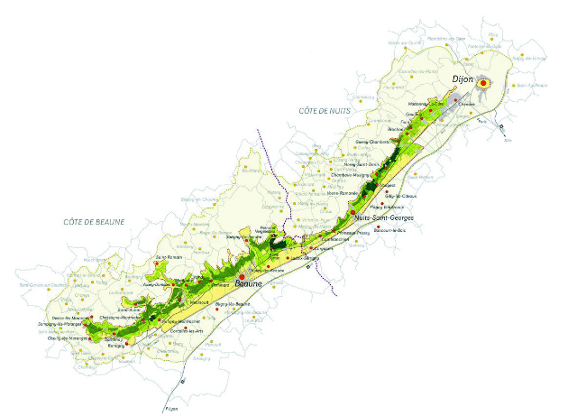
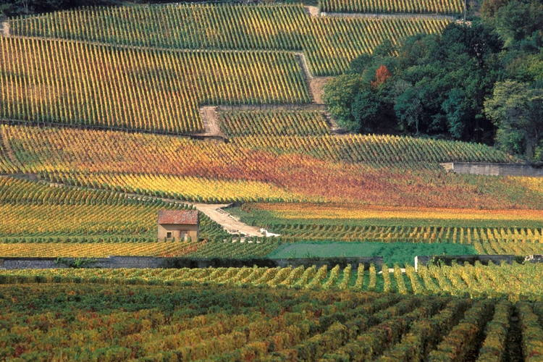
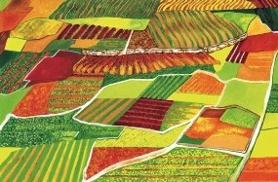
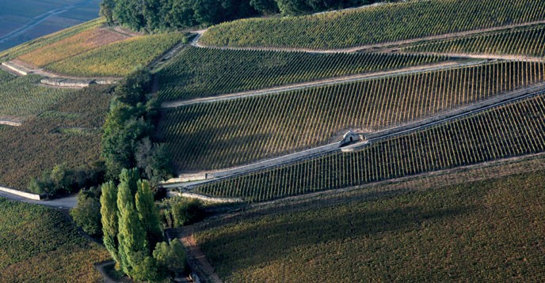

Slide 21
4.Landscape of Piedmont, Italy - History
The area includes the Castle of Cavour and five wine-growing regions in the southern part of Piedmont, between the river Po and the Ligurian Apennines;
Research shows that the earliest traces of winemaking in this area date back to the fifth century BC, while the area was important for wine production during the Roman Empire;
Since the 19th century, the area has been especially important in the wine market;
Since 2014, it has been under UNESCO protection based on the fulfillment of criteria (iii) and (v).

Slide 22
4.Landscape of Piedmont, Italy - Character
The region is famous for red wines made from grapes Nebbiolo, Barbera, Dolcetto, and white wines made from Cortese, Arneis, and Moscato;
The vineyards are built on slopes located at an altitude of between 150 to 450m above sea level;
The area is authentic from exceptional natural and cultural values, not only because of the long tradition of making wine and growing vines, but also because of cultivated hillsides, vernacular architecture, castles, numerous farms, wine cellars, churches, and cellars for commercialization. wines in populated areas;
Wine culture is the basic highlight of this area and is reflected in the evolution of winemaking, wine quality, wine routes, wine museums, and cellars, which attract a large number of tourists.

Slide 23
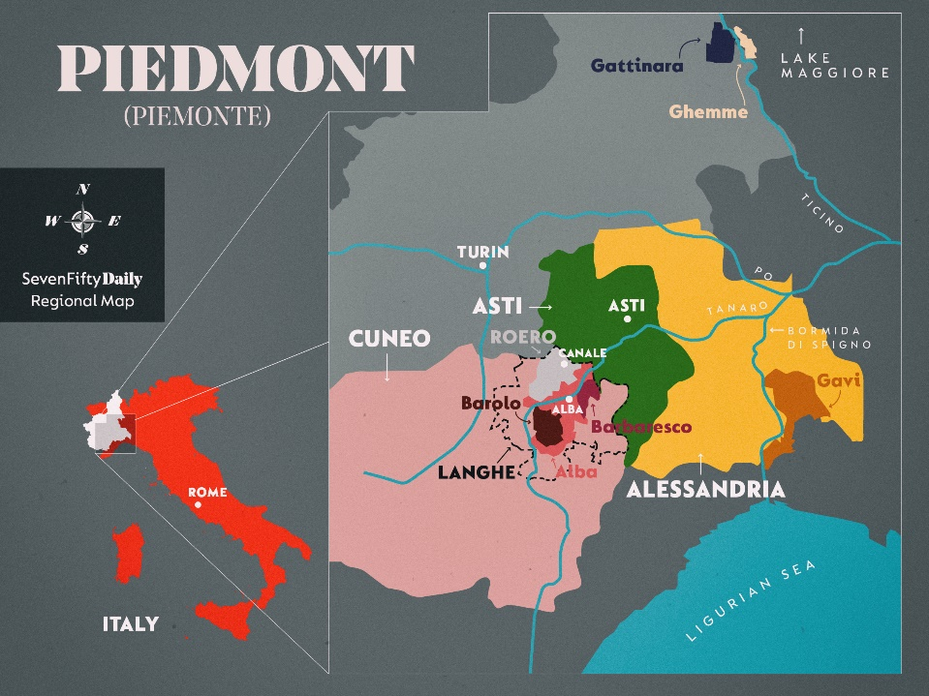
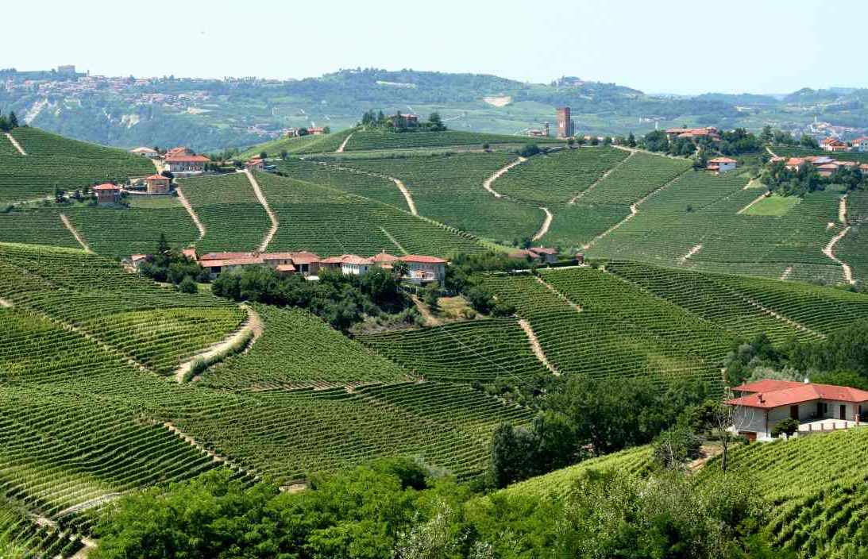
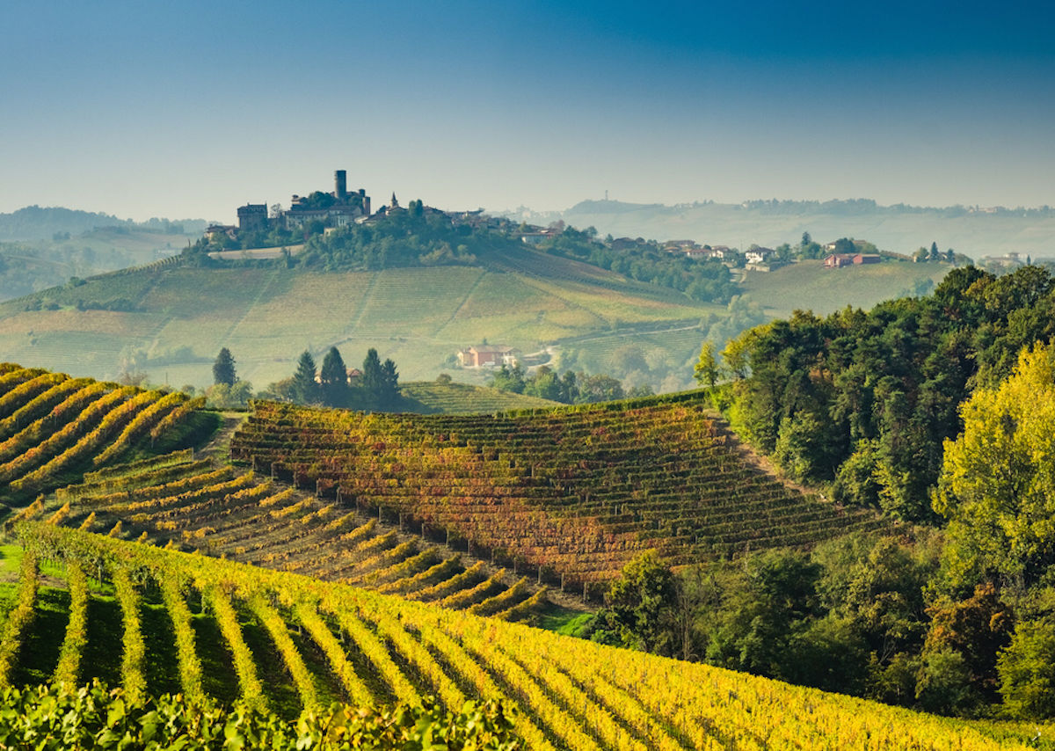
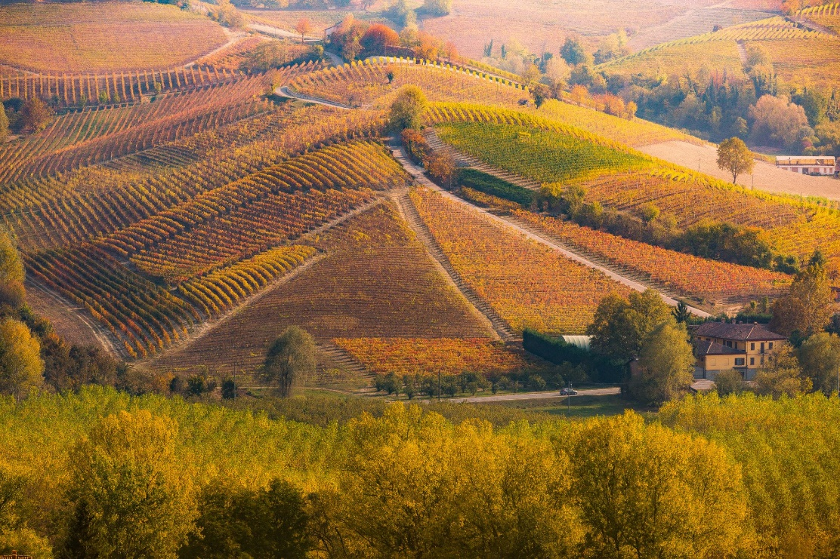

Slide 24
Conclusion
The conducted comparative analysis led to the following:
examples are included in the UNESCO list due to criteria (iii) and (v);
examples show characteristics that can be universal when it comes to wine production and viticulture-the possibility of considering other vineyard territories for enrollment in World H. List;
in terms of natural elements the following stand out as common: autochthonous grape species grown in this area, the unique microclimates in combination with the specific geological structure;
in terms of cultural elements as common stand out- long traditions of winemaking, vernacular architecture of buildings used in the production and storage of wine, specific cultural routes of movement of people, the specific urban layout of the area and authentic buildings.

Slide 25
Conclusion
The research was conducted to draw attention to the importance of cultural landscapes and wine landscapes;
The obtained conclusions open opportunities for further research that would refer to the examined potentials of wine regions in other areas of Europe, including Serbia, which have a long tradition in wine production and climatic conditions for its cultivation.

Slide 26
Thank you for your attention!

